Slide 1


Ellipsis Tech Series Hackathon
Team Solidos
Chew Jia Rong, Chong Kai Yun, Denyse Tan, Robbie Ng, Peng You Xuan

Slide 2
Our Vision

Slide 3

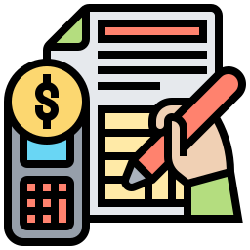

Our Unique Features
Goal-Based Profile
Budget Tracking Tool
Bite-Size Information
Notes:
Algorithm recommends smartest decisions on how to best use your money
Get your budgeting in total control with easy-to-use tools.
Real-Time news from various publications
Break down various types of investments to be easily digestible

Slide 4

App Walkthrough

Slide 5



Architecture Advantages
Scalable
Built on microservices and APIs, adding features are extremely convenient.
Easy Maintenance
Functionalities are easy to implement and fix if bugs arise.
Loosely Coupled
Legacy microservices can be easily removed and new microservices can be added with ease.

Slide 6

THANK YOU

